Slide 1
Computer Communication & Networks
Lecture on
Introduction to Data Communication

Slide 2
Data Communications
The term telecommunication means communication at a distance. The word data refers to information presented in whatever form is agreed upon by the parties creating and using the data. Data communications are the exchange of data between two devices via some form of transmission medium such as a wire cable.

Slide 3
Fundamental Characteristics
The effectiveness of a data communication system depend on four fundamental characteristics:
  Delivery
  Accuracy
  Timelines
  Jitter

Slide 4
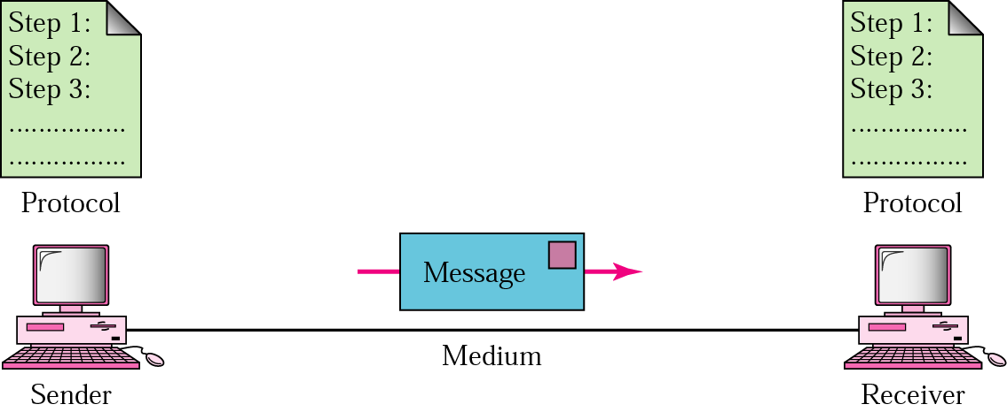
Five Components of Data Communication
Message
Sender
Receiver
Medium
Protocol

Slide 5
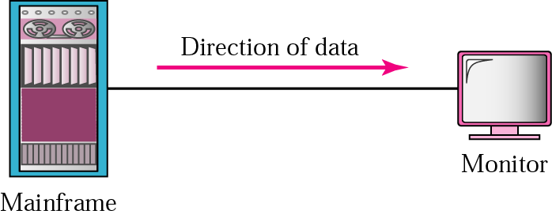
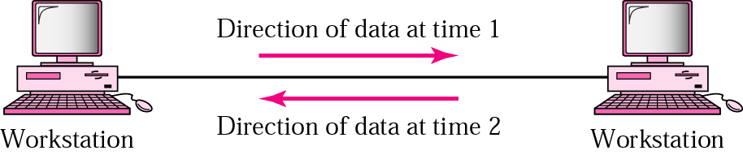
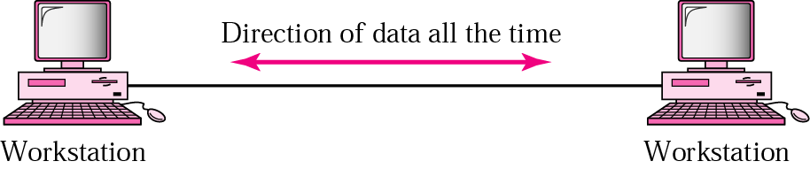
Direction of data flow
Simplex
Half Duplex
Full Duplex

Slide 6
Networks: key issues
Network criteria
  Performance
    Throughput
    Delay
  Reliability
    Data transmitted are identical to data received.
    Measured by the frequency of failure
    The time it takes a link to recover from a failure
  Security
    Protecting data from unauthorized access

Slide 7
Terminology
The throughput or bandwidth of a channel is the number of bits it can transfer per second
The latency or delay of a channel is the time that elapses between sending information and the earliest possible reception of it

Slide 8
Network topologies
Topology defines the way hosts are connected to the network

Slide 9
Network topology issues
a goal of any topology
high throughput (bandwidth)
low latency

Slide 10
Bandwidth and Latency
Bandwidth
1. telecommunications: range of radio frequencies: a range of radio frequencies used in radio or telecommunications transmission and reception
2. computing: communications capacity: the capacity of a communications channel, for example, a connection to the Internet, often measured in bits per second
3. a data transmission rate; the maximum amount of information (bits/second) that can be transmitted along a channel
Latency
A synonym for delay, is an expression of how much time it takes for transmission from one designated point to another

Slide 11

Categories of Topology

Slide 12
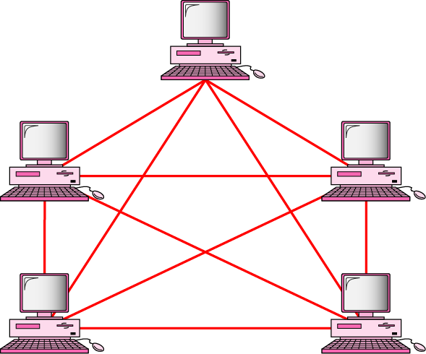
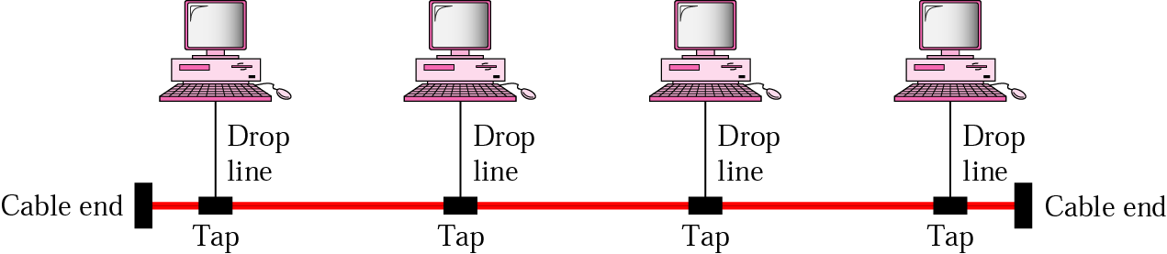
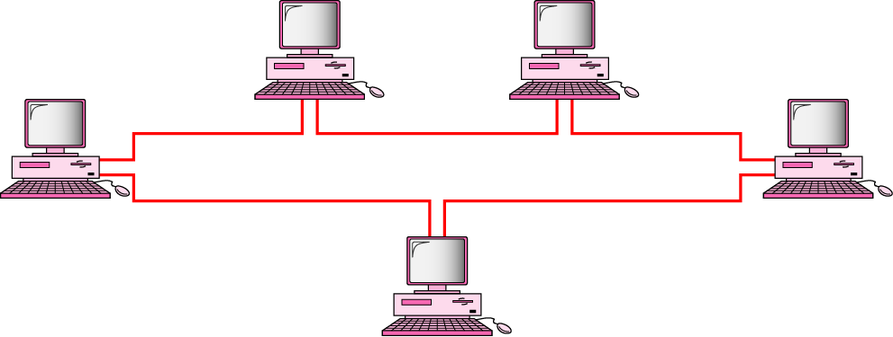
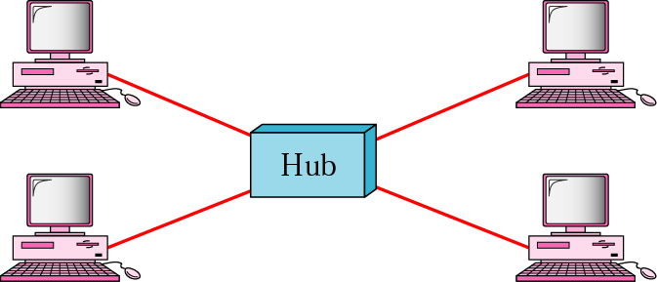
Mostly used network topologies
bus
mesh
ring
star

Slide 13

A hybrid topology: a star backbone with three bus networks

Slide 14

Hierarchical organization of the Internet

Slide 15
Layering & Protocol Stacks

Slide 16
What’s a protocol?
human protocols:
“what’s the time?”
“I have a question”
introductions
… specific msgs sent
… specific actions taken when msgs received, or other events
network protocols:
machines rather than humans
all communication activity in Internet governed by protocols

Slide 17



Protocol
protocols define format, order of msgs sent and received among network entities, and actions taken on msg transmission, receipt
a human protocol and a computer network protocol:
time
Hi
TCP connection
req.
Hi
TCP connection
reply.
Got the
time?
Get http://gaia.cs.umass.edu/index.htm
2:00
<file>

Slide 18
Standard
Essential in creating and maintaining an open and competitive market for equipment manufacturers
Guaranteeing national & international interoperability of data & telecommunication technology & process.

Slide 19
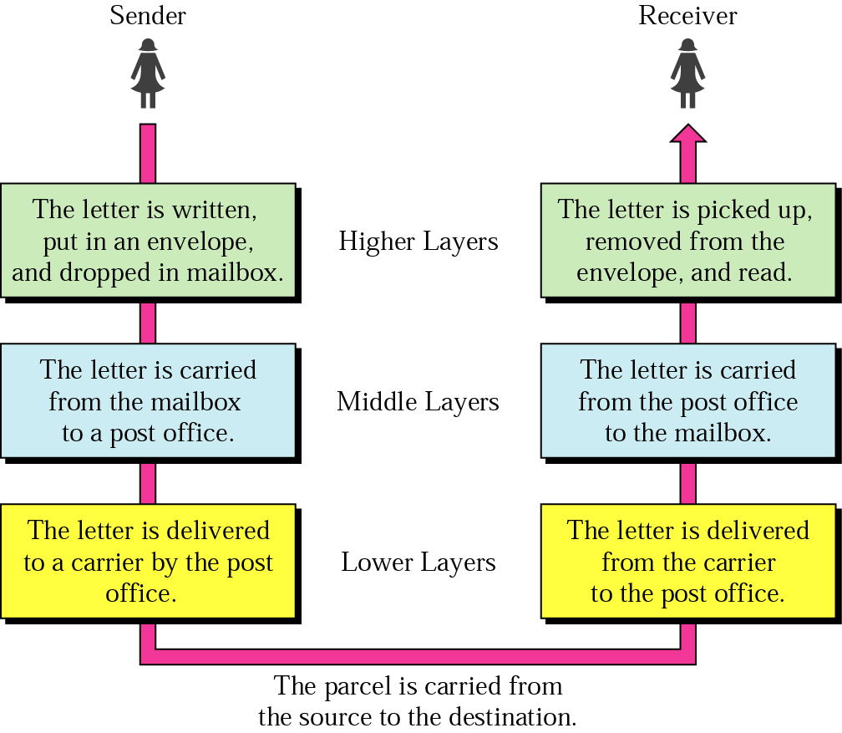




Layered Tasks
An example from the everyday life
Hierarchy?
Services

Slide 20
Why layered communication?
To reduce complexity of communication task by splitting it into several layered small tasks
Functionality of the layers can be changed as long as the service provided to the layer above stays unchanged
  makes easier maintenance & updating
Each layer has its own task
Each layer has its own protocol

Slide 21
Reference Models
OSI reference model
TCP/IP
Notes:
The OSI model is based on a proposal developed by the International Standards Organization (ISO) as a first step toward international standardization of the protocols used in the various layers.
The model is called the ISO-OSI (Open Systems Interconnection) Reference Model because it deals with connecting open systems—that is, systems that are open for communication with other systems.The OSI model is a layered framework for the design of network systems that allows communication between all types of computer systems. It consists of seven separate but related layers, each of which defines a part of the process of moving information across a network.
The TCP/IP protocol suite was developed prior to the OSI model. Therefore, the layers in the TCP/IP protocol suite do not exactly match those in the OSI model. The original TCP/IP protocol suite was defined as having four layers: host-to-network, internet, transport, and application.

Slide 22
OSI Reference model
Open System Interconnection
7 layers
Create a layer when different abstraction is needed
Each layer performs a well define function
Functions of the layers chosen taking internationally standardized protocols
Number of layers – large enough to avoid complexity

Slide 23

Seven layers of the OSI model
Notes:
The physical layer coordinates the functions required to carry a bit stream over a physical medium. It deals with the mechanical and electrical specifications of the interface and transmission medium.
The data link layer transforms the physical layer, a raw transmission facility, to a reliable link. It makes the physical layer appear error-free to the upper layer (network layer).
The network layer is responsible for the source-to-destination delivery of a packet, possibly
across multiple networks (links). Whereas the data link layer oversees the delivery of the packet between two systems on the same network (links), the network layer ensures that each packet gets from its point of origin to its final destination.
The transport layer is responsible for process-to-process delivery of the entire message.
The session layer is the network dialog controller. It establishes, maintains, and synchronizes the interaction among communicating systems.
The presentation layer is concerned with the syntax and semantics of the information exchanged between two systems.
The application layer enables the user, whether human or software, to access the network. It provides user interfaces and support for services such as electronic mail, remote file access and transfer, shared database management, and other types of distributed information services.

Slide 24

Exchange using OSI Model

Slide 25

The interaction between layers in the OSI model

Slide 26
Issues, to be resolved by the layers
Larger bandwidth at lower cost
Error correction
Flow control
Addressing
Multiplexing
Naming
Congestion control
Mobility
Routing
Fragmentation
Security
....

Slide 27
OSI Layers

Slide 28
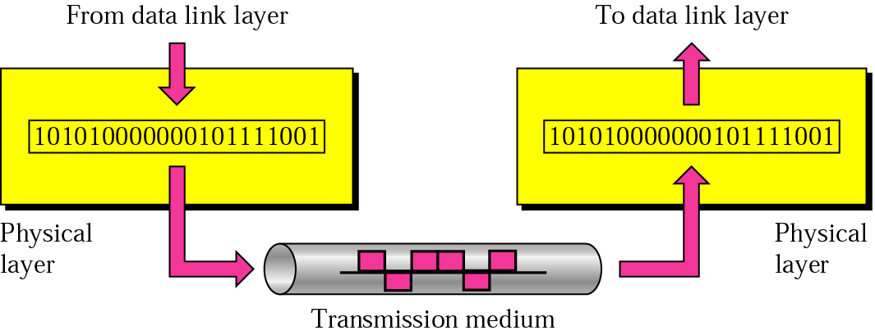
Physical layer
physical
connection
Transporting bits from one end node to the next
type of the transmission media (twisted-pair, coax, optical fiber, air)
bit representation (voltage levels of logical values)
data rate (speed)
synchronization of bits (time synchronization)

Slide 29

Note
The physical layer is responsible for movements of
individual bits from one hop (node) to the next.

Slide 30
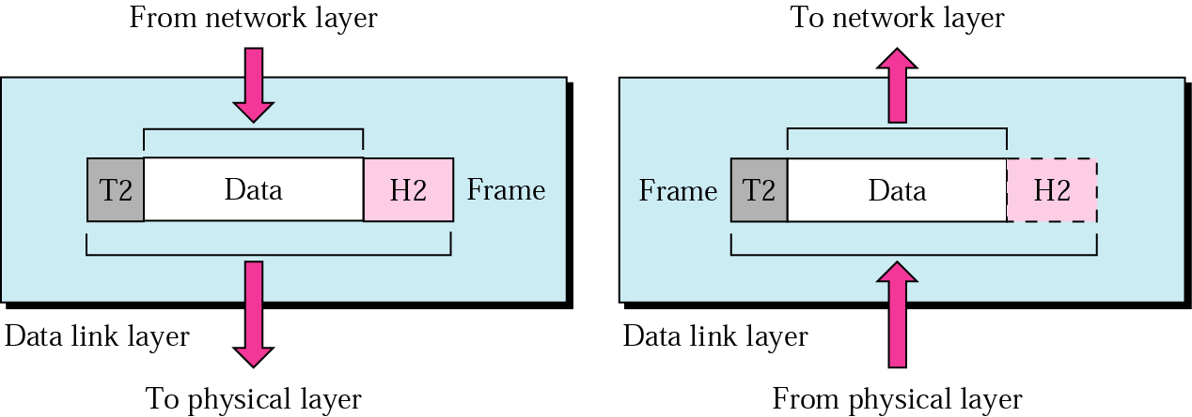
Data Link layer
logical
connection
Transporting frames from one end node to the next one
- framing - physical addressing
- flow control - error control
access control

Slide 31
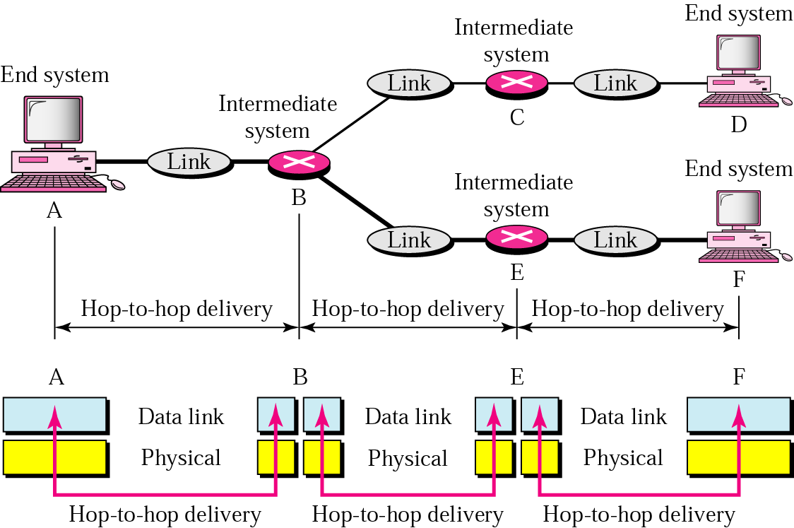
Data Link layer
- hop-to-hop delivery-

Slide 32
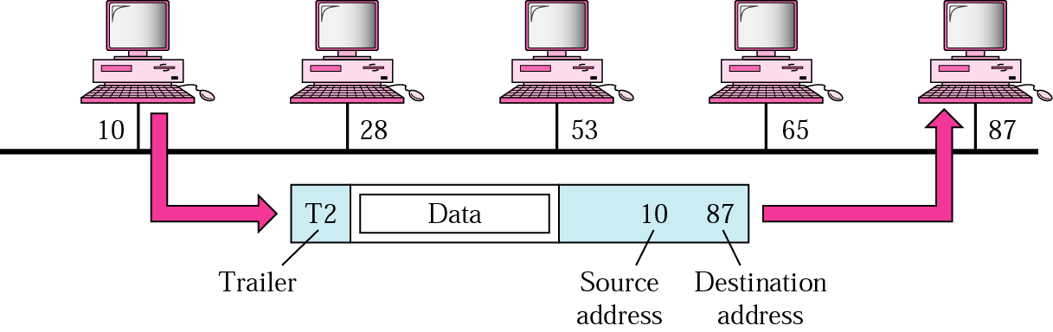
Data Link layer
- example-

Slide 33
Note
The data link layer is responsible for moving
frames from one hop (node) to the next.

Slide 34


